Slide 1
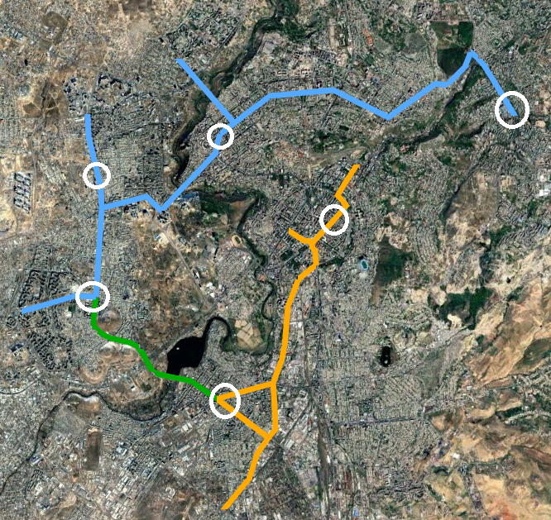
Parking Assessment
Parking Assessment
Our goal
• Analyse the existing parking system context along the priority corridors and in Yerevan as a whole.
• Assess the impacts of the conceptual corridor designs on parking supply.
• Evaluate the potential for parking displacement within the defined influence area.
• Identify mitigation options and parking management measures that support corridor implementation.
What we did
• Parking Supply Survey — desk inventory from 360° video, satellite and Yandex imagery, with ~15% cross-checked physically in the field.
• Parking Occupancy Survey — six representative areas, hourly license-plate sweeps, 07:00–24:00.
• Off-street context — major facilities on the corridors catalogued to test their potential to absorb displaced demand.
• All survey data published and explorable at http://yerevan-parking.vercel.app
Field occupancy survey areas
1

Slide 2
Parking Assessment
Parking Supply Survey
Across the corridors and 100 m buffer
15,897
8,862
7,005
7,035
Total spaces inventoried
On-street, across 728 segments
On the corridors themselves
Off-street, across 266 facilities
On-corridor on-street supply by regulatory zone (7,005 spaces)
Free / unregulated 6,144 (87.7%)
Zone B (blue) – paid 534 (7.6%)
Zone A (red) – paid 260 (3.7%)
Taxi 67 (1.0%)
88% of corridor parking is free of charge — and barely organized
• Only 20% has signage and 12% has markings. Zone A is concentrated in Kentron (Nalbandyan 83, Abovyan 46, Amiryan 43); Zone B is almost entirely Komitas Avenue (522 of 534).
2

Slide 3
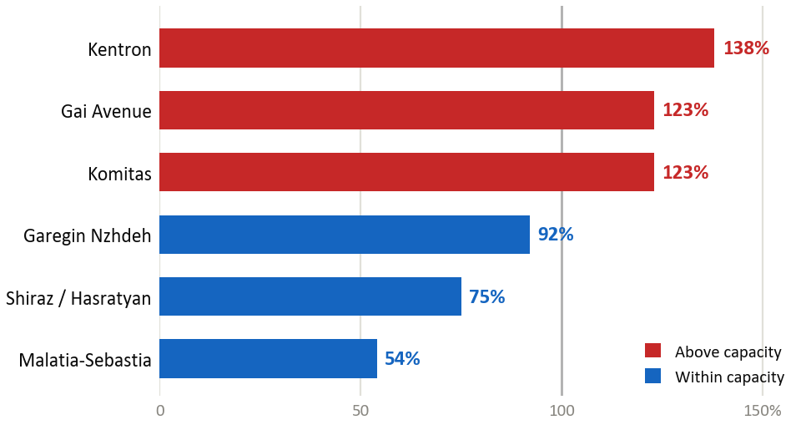
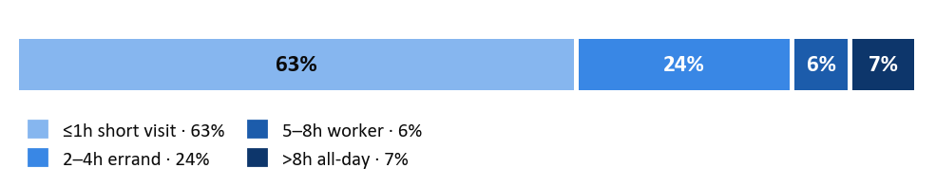
Parking Assessment
Parking Occupancy Survey
6 areas | hourly license-plate sweeps | 29 May - 3 June 2026 | 07:00–24:00
Peak occupancy by surveyed area
93%
1.8h
Peak occupancy, capacity-weighted
Average length of stay
5–11
63%
Vehicles per space per day
Of stays are one hour or less
How long vehicles stay
Peak occupancy = distinct vehicles in the busiest hour ÷ parking capacity (capacity-weighted).
3

Slide 4
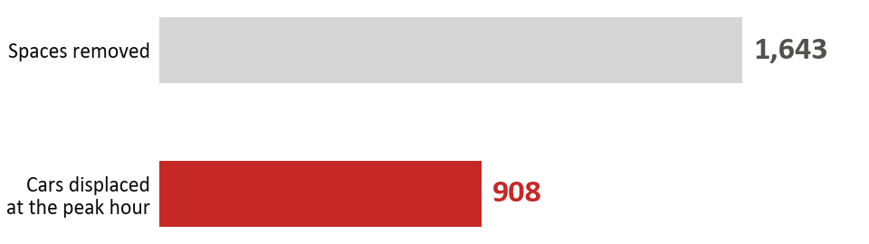
Parking Assessment
Design Impact & Displacement Assessment
The conceptual cross-section removes 85% of on-corridor parking
CORRIDOR-WIDE · impact of the conceptual design
Corridor 1: 1,836 · Corridor 2: 3,310 · Corridor 3: 807
7,005
5,953
85%
1,052
On-street, on the corridors
On-street spaces removed
Of on-corridor parking
Retained or re-established
SIX SURVEYED AREAS ONLY · measured displacement
A demand overlay — not a re-survey of the full corridor
55%
43%
92%
Displaced vs. removed
Absorbed on-street
Capacity behind gates
Displaced demand = distinct vehicles in the removed zones at each area's single busiest hour, summed across the six areas.
Open and manage the yards BEFORE removing kerb: nearby streets absorb only 43% (14% in Kentron, 0% in Komitas). Re-absorption reaches ~100% only via off-street, and 92% of that is gated residential yards.
4

Slide 5
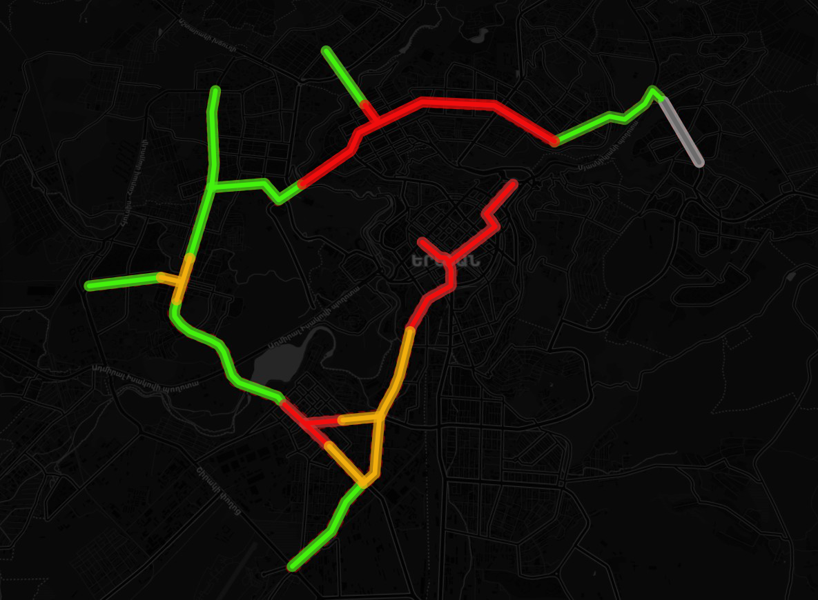











Parking Assessment
Mitigation Measures by Sensitivity Zones
No single measure resolves displacement - the package is applied selectively, by measured zone sensitivity
HIGH SENSITIVITY
Extend paid zones LEAD
Resident permits
Open residential yards PRECONDITION
Visitor caps CONTINGENCY
Delivery bays
MEDIUM SENSITIVITY
Extend paid zones
Delivery bays
Park & ride
High
Medium
Lower
LOWER SENSITIVITY
Organise free parking
Park & ride
Exception — Gai Avenue (Mega Mall)
Open residential yards
• Kerb parking stays for now; revisit as the area changes - mall parking or the planned BRT.
5

Slide 6
Parking Assessment
Further studies and considerations
Parking is a citywide system and cannot be sustainably managed at corridor level alone
This component is scoped to the BRT corridors and their immediate influence area. The measures proposed here should therefore be understood as the first stage of a broader, citywide reform.
Extend the approach citywide
Supporting studies
• Extend the parking study beyond the corridor buffer to a citywide scale.
• Apply focused demand assessments at selected high-pressure locations, rather than corridor-wide observational surveys.
• Progressively expand the red-line zonal system into neighbourhoods currently outside it.
• Residential yard opening.
• Legal basis of the resident permit scheme.
• Park & ride feasibility.
Priority: who administers residential-yard opening
• The yards carry ~92% of the absorptive capacity that makes re-absorption work, yet no body currently owns the task. Who should lead it, and under what organisational and legal arrangement, warrants a dedicated study before any roll-out.
6

